Slide 1





High-Quality Programming Code
Code Correctness, Readability, Maintainability, Testability, Etc.
SoftUni Team
Technical Trainers
Software University
http://softuni.bg

Slide 2

Table of Contents
Why Quality Is Important?
Software Quality: External and Internal
What is High-Quality Code?
Code Conventions
Managing Complexity
Characteristics of Quality Code

Slide 3


What is High-Quality Programming Code?

Slide 4

Why Quality Is Important?
What does this code do? Is it correct?
static void Main()
{
int value=010, i=5, w;
switch(value){case 10:w=5;Console.WriteLine(w);break;case 9:i=0;break;
case 8:Console.WriteLine("8 ");break;
default:Console.WriteLine("def ");{
Console.WriteLine("hoho "); }
for (int k = 0; k < i; k++, Console.WriteLine(k - 'f'));break;} { Console.WriteLine("loop!"); }
}

Slide 5

Why Quality Is Important? (2)
Now the code is formatted, but is still unclear
static void Main()
{
int value = 010, i = 5, w;
switch (value)
{
case 10: w = 5; Console.WriteLine(w); break;
case 9: i = 0; break;
case 8: Console.WriteLine("8 "); break;
default:
Console.WriteLine("def ");
Console.WriteLine("hoho ");
for (int k = 0; k < i; k++,
Console.WriteLine(k - 'f')) ;
break;
}
Console.WriteLine("loop!");
}

Slide 6


Software Quality
External quality
Does the software behave correctly?
Are the produced results correct?
Does the software run fast?
Is the software UI easy-to-use?
Is the code secure enough?
Internal quality
Is the code easy to read and understand?
Is the code well structured?
Is the code easy to modify?

Slide 7

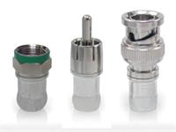
What is High-Quality Programming Code?
High-quality programming code:
Easy to read and understand
Easy to modify and maintain
Correct behavior in all cases
Well tested
Well architectured and designed
Well documented
Self-documenting code
Well formatted

Slide 8

What is High-Quality Programming Code? (2)
High-quality programming code:
Strong cohesion at all levels: modules, classes, methods, etc.
Single unit is responsible for single task
Loose coupling between modules, classes, methods, etc.
Units are independent one of another
Good formatting
Good names for classes, methods, variables, etc.
Self-documenting code style

Slide 9



Code Conventions

Slide 10

Code Conventions
Code conventions are formal guidelines about the style of the source code:
Code formatting conventions
Indentation, whitespace, etc.
Naming conventions
PascalCase or camelCase, prefixes, suffixes, etc.
Best practices
Classes, interfaces, enumerations, structures, inheritance, exceptions, properties, events, constructors, fields, operators, etc.

Slide 11
Code Conventions (2)
Microsoft official C# code conventions
Design Guidelines for Developing Class Libraries: http://msdn.microsoft.com/en-us/library/ms229042.aspx
Java official code conventions
http://www.oracle.com/technetwork/java/codeconvtoc-136057.html
Semi-official JavaScript code conventions
http://javascript.crockford.com/code.html, http://google-styleguide.googlecode.com/svn/trunk/javascriptguide.xml
Semi-official PHP conventions
http://www.php-fig.org/psr/psr-1/

Slide 12



Managing Complexity

Slide 13
Managing Complexity
Managing complexity has a central role in software construction
Minimize the amount of complexity that anyone’s brain has to deal with at certain time
Architecture and design challenges
Design modules and classes to reduce complexity
Code construction challenges
Apply good software construction practices: classes, methods, variables, naming, statements, error handling, formatting, comments, unit testing, etc.

Slide 14

Managing Complexity (2)
Key to being an effective programmer:
Maximizing the portion of a program that you can safely ignore
While working on any one section of code
Most practices discussed later propose ways to achieve this important goal

Slide 15

Code Quality: Characteristics

Slide 16


Key Characteristics of High-Quality Code
Correct behavior
Conforming to the requirements
Stable, no hangs, no crashes
Bug free – works as expected
Correct response to incorrect usage
Readable – easy to read
Understandable – self-documenting
Maintainable – easy to modify when needed

Slide 17
Key Characteristics of High-Quality Code (2)
Good identifiers names
Good names for variables, constants, methods, parameters, classes, structures, fields, properties, interfaces, structures, enumerations, namespaces,
High-quality classes, interfaces and class hierarchies
Good abstraction and encapsulation
Correct use of inheritance and polymorphism
Simplicity, reusability, minimal complexity
Strong cohesion, loose coupling

Slide 18

Key Characteristics of High-Quality Code (3)
High-quality methods
Reduced complexity, improved readability
Good method names and parameter names
Strong cohesion, loose coupling
Variables, data, expressions and constants
Minimal variable scope, span, live time
Simple expressions
Correctly used constants
Correctly organized data

Slide 19


Key Characteristics of High-Quality Code (4)
Correctly used control structures (if, switch)
Simple statements
Simple conditional statements and simple conditions
Well organized loops without deep nesting
Good code formatting
Reflecting the logical structure of the program
Good formatting of classes, methods, blocks, whitespace, long lines, alignment, etc.

Slide 20



Key Characteristics of High-Quality Code (5)
High-quality documentation and comments
Effective comments
Self-documenting code
Defensive programming and exceptions
Ubiquitous use of defensive programming
Well organized exception handling
Code tuning and optimization
Quality code instead of good performance
Code performance when required

Slide 21
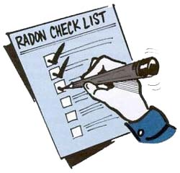
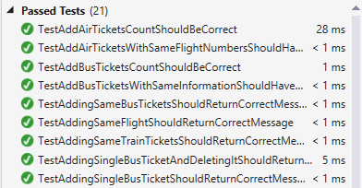
Key Characteristics of High-Quality Code (6)
Following the corporate code conventions
Formatting and style, naming, etc.
Domain-specific best practices
Well tested and reviewed
Testable code
Well designed unit tests
Tests for all scenarios
High code coverage
Passed code reviews and inspections

Slide 22
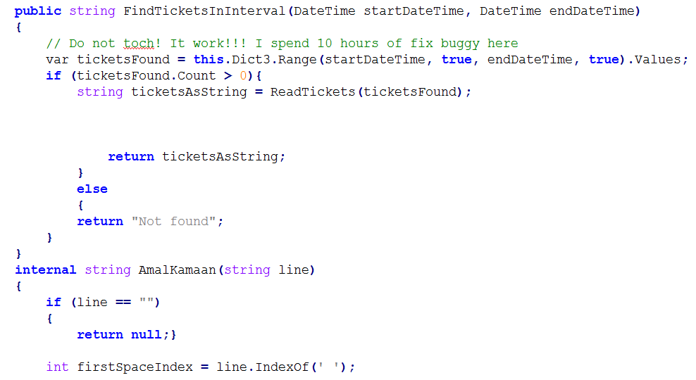
Low-Quality and High-Quality Code
Live Demo: Code from the Last Exam

Slide 23

Summary
Software Quality
External quality – software works correctly, no bugs and other problems
Internal quality – code is well structured, readable and maintainable
Aspects of Code Quality
Quality classes, methods, control statements, loops, etc.
Good formatting, comments, strong cohesion and loose coupling
Testable code with unit tests

Slide 24
High-Quality Programming Code
https://softuni.bg/courses/high-quality-code/

Slide 25

License
This course (slides, examples, demos, videos, homework, etc.) is licensed under the "Creative Commons Attribution-NonCommercial-ShareAlike 4.0 International" license
Attribution: this work may contain portions from
"High Quality Code" course by Telerik Academy under CC-BY-NC-SA license

Slide 26







SoftUni Diamond Partners

Slide 27





Free Trainings @ Software University
Software University Foundation – softuni.org
Software University – High-Quality Education, Profession and Job for Software Developers
softuni.bg
Software University @ Facebook
facebook.com/SoftwareUniversity
Software University @ YouTube
youtube.com/SoftwareUniversity
Software University Forums – forum.softuni.bg

